Slide 1
Welcome to Unit 1 Intro to Text Analysis Or, Four Ways of Reading a Text
Delivered/Adapted: Prof. Mackenzie Brooks
DCI 102: Data in the Humanities
September 17, 2019
Created by Dr. Brandon Walsh // CC-BY

Slide 2
Love Notes
Dear headphone jack, I love you. I mean you’re great and all. And I really love you. But I’ve been thinking a lot. And we should talk soon. But I love you. Definitely don’t worry. Yours,
Apple
Notes:
Start with a kind of reading that we do all the time
Tell me some things about this note.
Is it a love note? A break up note? How do you know? Attention to details, attention to particulars.

Slide 3
1. Close Reading
Every detail matters
Every detail matters whether the author intended them or not
In most cases, assumes that meaning is hidden
You have to uncover meaning by connecting small details
Context matters

Slide 4
1. Close Reading
Handout has five paragraphs on it.
Read them normally.
Pay close attention to every detail.
Discuss with your partner.
Notes:
For follow up try to get them to focus on some particulars.
Guiding questions:
What kind of a text is it? What does it care about? What kind of a world is it depicting?

Slide 5
1. Close Reading
Used a lot in literary studies, history, etc.
Also just in everyday life.
Generally a version of how you conduct life.
Overanalyzing life events – a kind of close reading.
Notes:
But notice how this puts the interpretation directly interacting with the text. That’s a problem for computers, which are really pretty dumb.
They’re good for repetitive things. And for counting things. So we’re going to take a look at some different ways that you can count things with computers to give you new opportunities for interpretations.

Slide 6
2. Bag of Words
Vocabulary is basic premise of meaning.
You can find out something interesting about a text just by looking at the vocabulary.
In practice, means you’re just counting words.
Notes:
First way is to literally just count the words in a text.

Slide 7
"Fine. How are you doing?"
"How are you doing? Fine?”
Bag of words models for both:
[“fine”, “how”, “are”, “you”, “doing”]
Notes:
To count these things, you’ll first want to make a list of the words. Here’s an example. Notice that we are combining both sentences.

Slide 8
2. Bag of Words
Sentence A: "Barbara is doing fine, thank you."
Sentence B: "Thank you, Dave. I am doing fine.”
Make a Bag of Words model for these sentences.
Notes:
So take these two sentences and make a bag of words model that combines both sentences.

Slide 9
2. Bag of Words
Sentence A:
"Barbara is doing fine, thank you."
Sentence B:
"Thank you, Dave. I am doing fine.”
Words in Corpus
[
"Barbara",
"is",
"doing",
"fine",
"thank",
"you",
"Dave,
"I",
"am"
]
Counts for Sentences
A: [1, 1, 1, 1, 1, 1, 0, 0, 0]
B: [0, 0, 1, 1, 1, 1, 1, 1, 1]
Notes:
Notice that you can also count the words. What happens here is we have a new list of numbers for each sentence. One spot for each word. And we list the number of times that the words occur in our sentences. Questons?
Corpus = collection of written texts

Slide 10
2. Bag of Words
Expand the BoW model to include this sentence:
Sentence C: "I am Dave"
Notes:
Expand the BOW model to include this sentence.

Slide 11
2. Bag of Words
Sentence A:
"Barbara is doing fine, thank you."
Sentence B:
"Thank you, Dave. I am doing fine.”
Sentence C:
“I am Dave.”
Counts for Sentences
A: [1, 1, 1, 1, 1, 1, 0, 0, 0]
B: [0, 0, 1, 1, 1, 1, 1, 1, 1]
C: [0, 0, 0, 0, 0, 0, 1, 1, 1]
Words in Corpus
[
"Barbara",
"is",
"doing",
"fine",
"thank",
"you",
"Dave,
"I",
"am"
]
Notes:
Is this what you got? Questions?

Slide 12
2. Bag of Words
Take the paragraph in front of you from the Programming Historian on Mallet.
With a partner, make a bag of words model for it that includes counts for the number of times each word appears.
Probably easiest to start a list of words on a separate sheet of paper.
When you get a new word, add it to the list and count up the number of times it occurs. Cross out all instances of that word in the paragraph and move onto the next one.
At the end, order them by frequency.
Notes:
Now a more extensive version of the same exercise. Might work well to divide up the tasks.

Slide 13
2. Bag of Words
[('the', 6), ('.', 5), ('to', 5), ('will', 4), (',', 4), ('and', 4), ('MALLET', 4), ('of', 3), ('in', 3), ('a', 3), ('on', 3), ('topic', 2), ('you', 2), ('how', 2), ('that', 2), ('with', 2), ('it', 2), ('so', 2), ('learn', 2), ('your', 2), ('(', 2), (')', 2), ('first', 1), ('used', 1), ('reading', 1), ('idea', 1), ('natural', 1), ('an', 1), ('program', 1), ('computer', 1), ('us', 1), ('or', 1), ('files', 1), ('always', 1), ('language', 1), ('lesson', 1), ('This', 1), ('working', 1), ('rather', 1), ('than', 1), ('manually', 1), ('where', 1), ('short-cut', 1), ('look', 1), ('You', 1), ('might', 1), ('can', 1), ('identify', 1), ('do', 1), ('at', 1), ('texts', 1), ('give', 1), ('found', 1), ('want', 1), ('clicking', 1), ('example', 1), ('by', 1), ('find', 1), ('them', 1), ('toolkit', 1), ('corpus', 1), ('then', 1), ('be', 1), ('why', 1), ('line', 1), ('kinds', 1), ('employ', 1), ('outputs', 1), ('variable', 1), ('modeller', 1), ('install', 1), ('without', 1), ('up', 1), ('good', 1), ('We', 1), ('setting', 1), ('ie', 1), ('some', 1), ('modifying', 1), ('typing', 1), ('menus', 1), ('documents', 1), ('is', 1), ('environment', 1), ('research', 1), ('what', 1), ('commands', 1), ('icons', 1), ('this', 1), ('command', 1), ('In', 1), ('knows', 1), ('run', 1), ('topics', 1), ('processing', 1), ('modeling', 1), ('work', 1), ('individually', 1), ('involves', 1), ('essentially', 1)]
Notes:
Any differences?
Other questions? Did you do punctuation? Did you collapse capitalized words and uncapitalized? Singular vs plural.
What do you notice about this list? Anything interesting? What does this list suggest that the text is about?
Stopwords vs. hapax legemenon (only used once)
What is gained and lost here?

Slide 14
2. Bag of Words
Lose Context
You wouldn’t want to do this by hand (I cheated and did this with a computer).
But now computers can interact with texts.
Computers are dumb, but they’re good at math.
We can use these counts to do interesting things.
Notes:
Review

Slide 15
2. Bag of Words
Sentence A:
"Barbara is doing fine, thank you."
Sentence B:
"Thank you, Dave. I am doing fine.”
Sentence C:
“I am Dave.”
Counts for Sentences
A: [1, 1, 1, 1, 1, 1, 0, 0, 0]
B: [0, 0, 1, 1, 1, 1, 1, 1, 1]
C: [0, 0, 0, 0, 0, 0, 1, 1, 1]
Words in Corpus
[
"Barbara",
"is",
"doing",
"fine",
"thank",
"you",
"Dave,
"I",
"am"
]
Notes:
Let’s take a closer look at the sentences here.

Slide 16
2. Bag of Words
Sentence A:
"Barbara is doing fine, thank you."
Sentence B:
"Thank you, Dave. I am doing fine.”
Sentence C:
“I am Dave.”
Counts for Sentences
A: [1, 1, 1, 1, 1, 1, 0, 0, 0]
B: [0, 0, 1, 1, 1, 1, 1, 1, 1]
C: [0, 0, 0, 0, 0, 0, 1, 1, 1]
Notes:
Which sentences are more similar to the others? How might you tell?

Slide 17
A: [1, 1, 1, 1, 1, 1, 0, 0, 0]
B: [0, 0, 1, 1, 1, 1, 1, 1, 1]
C: [0, 0, 0, 0, 0, 0, 1, 1, 1]
A and C are inverses – share nothing.
B shares 4 terms with A
C shares 3 terms with B
Sentences Graphed by Similarity
A-----------B-----------------C
Notes:
A and C are mirror images of each other – they don’t share anything.
B’s relationship to A: shares 4 terms
B’s relationship to C: shares 3 terms (counting 0’s)
Just a way of showing you the kinds of things you can do when you convert things to numbers.

Slide 18
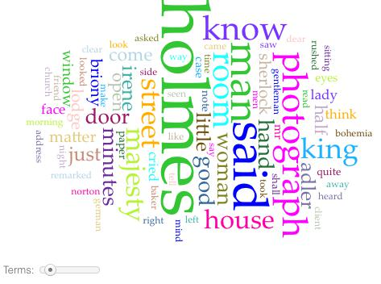
Bag of Words in Voyant
voyant-tools.org
Notes:
You can really do quite a lot just from counting words. Word cloud.
What is the text about (beyond Holmes)? How do you know?
voyant-tools.org

Slide 19
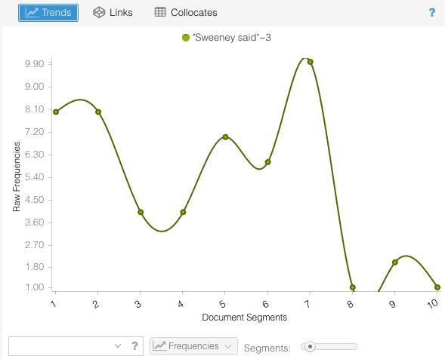
Bag of Words in Voyant
Notes:
Another thing. You can divide up a whole text into pieces and count words for particular sections. Gives you a sense of rise and fall of text counts over time.
String of Pearls here – the story sweeney todd is based on. What is this showing?

Slide 20
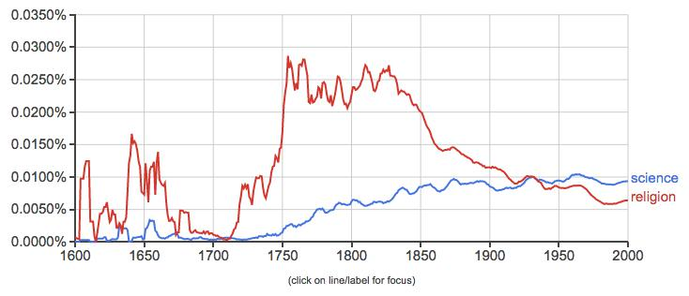
Google NGrams
https://books.google.com/ngrams
Notes:
Using the same principle, if you have more than one book, you track word usage over time. What does this graph seem to be telling you?
Explain what google ngrams is
https://books.google.com/ngrams

Slide 21
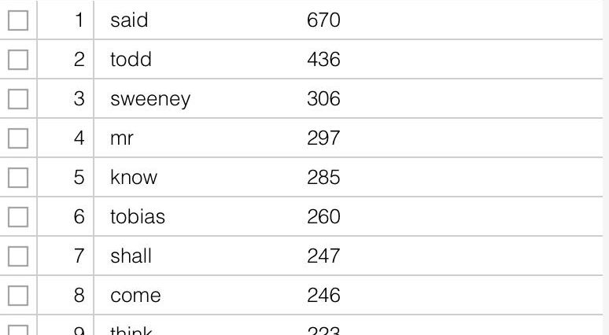
Concordance w/ Stopwords
Notes:
Remember stopwords? What is this?

Slide 22
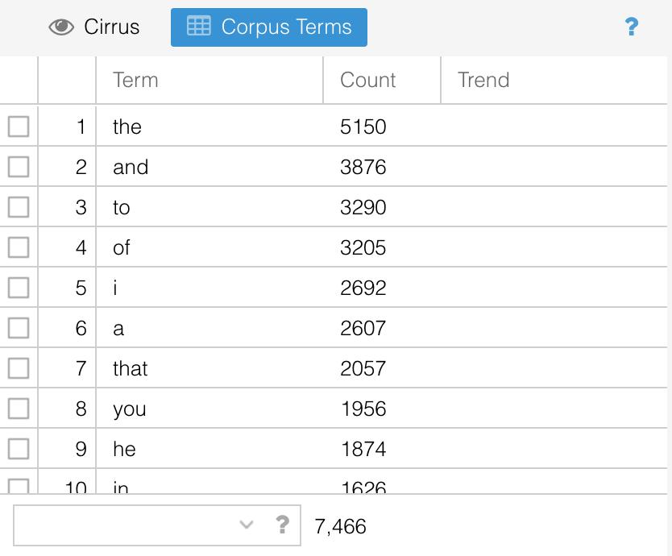
Concordance w/o Stopwords
Notes:
Gives you the stopword list basically.
It gives you a list of those words that you often don’t care about. Normally you ignore them.
But they CAN be good for telling you how someone is talking about something if not what they’re talking about.

Slide 23
3. Topic Modeling
You’re each given the scrambled text of three document.
What are they about? Pick 3 themes or topics for each text. Texts can share topics.
How do you know?
Notes:
Next activity – a more advanced form of counting words. Not just about counting individual words. It’s about telling what
Text 1 – Jack the Ripper, newspaper article
Text 2 – Sherlock Holmes, Scandal in Bohemia
Text 3 – http://www.npr.org/sections/health-shots/2016/09/13/493289511/doctors-test-drones-to-speed-up-delivery-of-lab-tests
What did you find?

Slide 24
3. Topic Modeling
Text 1: evidence, medicine, murder
Text 2: evidence, love, woman
Text 3: medicine, news, transportation
Notes:
You get anything else? How did you know what topics the texts had if you didn’t have the order of the words?
Not just about word count – it’s also about collocating words. Counting with an eye towards what words occur next to each other.

Slide 25
3. Topic Modeling
Variation of Bags of Words
Texts are about something – themes/topics
Vocabulary lets us know this.
So if we know the words, we can infer the topics.
But, more specifically, we want to look at clusters of words.
Notes:
The computer can do this for us!

Slide 26
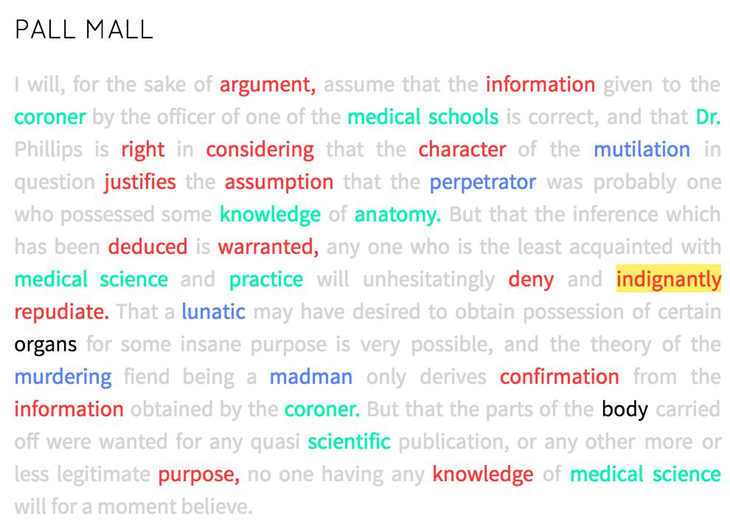
3. Topic Modeling
red: evidence
green: medicine
blue: murder
Notes:
This is text 1 in order. I ran it through a program – prism.scholarslab.org – to show the different themes. You might do it differently.
But when you’re reading, you probably do something similar.
Individual words suggest certain themes to you. And you internalize these when you read.
It’s also about clusters of these theme/topic rich words together.
We could go a step further and say that any text is made up a number of these themes, each of which is comprised of a series of words. When we read, we sift through the text and discern the themes at work. A flipped version would say that authors actually compose in the same way – they have buckets full of words that correspond to each theme. When composing this text, the author might have said something like:
I have some words related to evidence, some for medicine, and some for murder. I’m going to select some from each and arrange this text. But i’ll leave that bucket of words related to basketball alone.
A weird way to think about reading and writing / and it’s partially metaphor. But you can actually use a computer to work through metaphors like this for you.

Slide 27
3. Topic Modeling
Runs over a corpus
Pulls out statistically significant clusters of words in each document
More sophisticated than simple word counts
Gets at underlying themes/topics in docs
Notes:
So when you do topic modeling.
Assumes that there are significant topics or discourses at work in a text.
Tries to get at them by finding which words occur frequently together over time. At the end of the day, that results in a sense of the topic distribution.

Slide 28
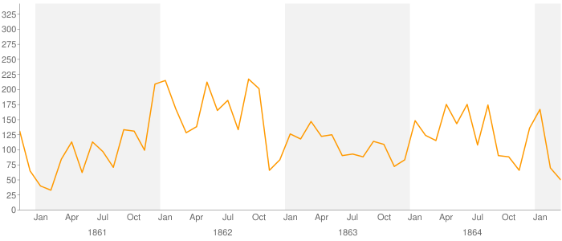
3. Topic Modeling
NEGRO YEARS REWARD BOY MAN NAMED JAIL DELIVERY GIVE LEFT BLACK PAID PAY RAN COLOR RICHMOND SUBSCRIBER HIGH APPREHENSION AGE RANAWAY FREE FEET DELIVERED
Fugitive Slave Ad topic from Mining the Dispatch
http://dsl.richmond.edu/dispatch/topics/view/15
Notes:
Here is an example of TM. If we have a whole lot of texts and we look at the topics over time, we can get a sense of how they change over time!
TM run over the Richmond Daily Dispatch during the civil war. This topic came to the surface. Knowing their corpus, they ID’d it as a fugitive slave topic. Charted over time, they can see that the number of fugitive slave ads spiked at particular times of union occupations – summer of 1862 and summer of 1864. “relative proximity of the union to enslaved people gave them a chance to escape or attempt to escape to freedom.
Their words - “What conclusions can we make from this kind of distant reading and draw from this graph specifically? For one, I think, this graph underscores the role of the Union army in presenting enslaved African Americans with opportunities—risky opportunities—to seize their freedom by running to the Yankee lines. There are two sustained spikes in the number of fugitive slave ads, the first in the summer of 1862 and the second in the summer of 1864. At both of those moments the Union army approached Richmond. In 1862 the Union army under McClennan approached within seven miles of Richmond during the Peninsula Campaign. (Jefferson Davis's coachman, William A. Jackson, was one of the slaves who ran to the Union army that spring.) Two summers later Grant's Overland Campaign brought Union armies near Richmond. The graph registers how during each of those summers enslaved men and women used to opportunity offered by relative proximity of the Union armies—which we might think of as a mobile North, bringing the free states closer to men and women enslaved in the South—to attempt to escape from bondage. A third spike at the end of 1861 is less explicable, and we'll return to it in a moment.”

Slide 29
4. Sentiment Analysis
How does a text feel?
Is it happy? Sad?
Complicated questions!
Let’s try to tell…
Notes:
One last type of reading. How do you tell if a text is happy or sad?

Slide 30
4. Sentiment Analysis
“I am very happy.”
“She is so sad.”
Notes:
Are these sentences happy or sad? How do you tell?

Slide 31
4. Sentiment Analysis
"It was the best of times, it was the worst of times…”
Notes:
Happy? Sad? How do you tell? Maybe there’s some other kind of measure?

Slide 32
4. Sentiment Analysis
"It was the best of times, it was the worst of times…”
Not a clear answer overall. We need a better way to register this. Let’s go word by word.
Notes:
Happy? Sad? How do you tell? Maybe there’s some other kind of measure?

Slide 33
4. Sentiment Analysis
"It
was
the
best happy!
of
times,
it
was
the
worst sad!
of
times…"

Slide 34
4. Sentiment Analysis
"It
was
the
best happy! / positive
of
times,
it
was
the
worst sad! / negative
of
times…"
Notes:
But remember computers like numbers. How might we register this?

Slide 35
4. Sentiment Analysis
"It
was
the
best happy! / positive / 1
of
times,
it
was
the
worst sad! / negative / -1
of
times…"

Slide 36
4. Sentiment Analysis
"It was the best of times, it was the worst of times…”
1 – 1
Total = 0
Overall neutral sentiment
Notes:
If we add up the numbers for the sentence, we can get a sense of the feelings in it.

Slide 37
4. Sentiment Analysis
Can imagine a range of emotions: good, better, best.
So you could use a range of numbers: good = +1, better= +3, best = +5
Say, assign any emotion-laden word a number between -5 and +5.
Keep in mind that you’re not reading for context. Simply on a word-by-word basis.
So “yes” would be positive. “no” would be negative

Slide 38
4. Sentiment Analysis
Chart the sentiment for each of the three excerpts on your handout.
Assign numerical values to the words then add up the numbers for each paragraph. Average them all at the end for each paragraph.
Which is happier? Sadder?
Happiest? Saddest?
Any problems or questions that this raises?
Notes:
Note in particular that Fahrenheit 451 appears to be the happiest.

Slide 39
4. Sentiment Analysis
Declaration: Negative
Kafka: Negative
Bradbury: Positive, right?
Notes:
What numbers did you get? Do some people have different numbers?
Note in particular that Fahrenheit 451 appears to be the happiest.
What do you make of this form of measure? What can you imagine it used for.
Can you imagine any way to make it work better? (have humans validate the results and tweak them)

Slide 40
4. Sentiment Analysis
Pretty Vexed
But intellectually interesting in itself
High stakes for businesses
https://open.nytimes.com/how-does-this-article-make-you-feel-4684e5e9c47
Notes:
https://open.nytimes.com/how-does-this-article-make-you-feel-4684e5e9c47

Slide 41
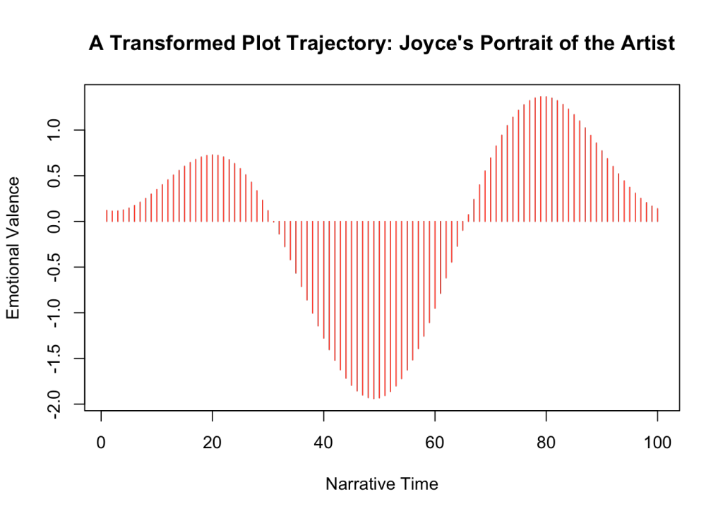
4. Sentiment Analysis
http://www.matthewjockers.net/2015/02/02/syuzhet/
Notes:
What can you do with sentiment analysis?
From a humanities perspective, you can say that by registering moments of happiness or sadness over time, you can measure a plot’s tension. You could get a sense of the plot arc in a text. Jockers claims there are really only six shapes if you do this kind of math.

Slide 42
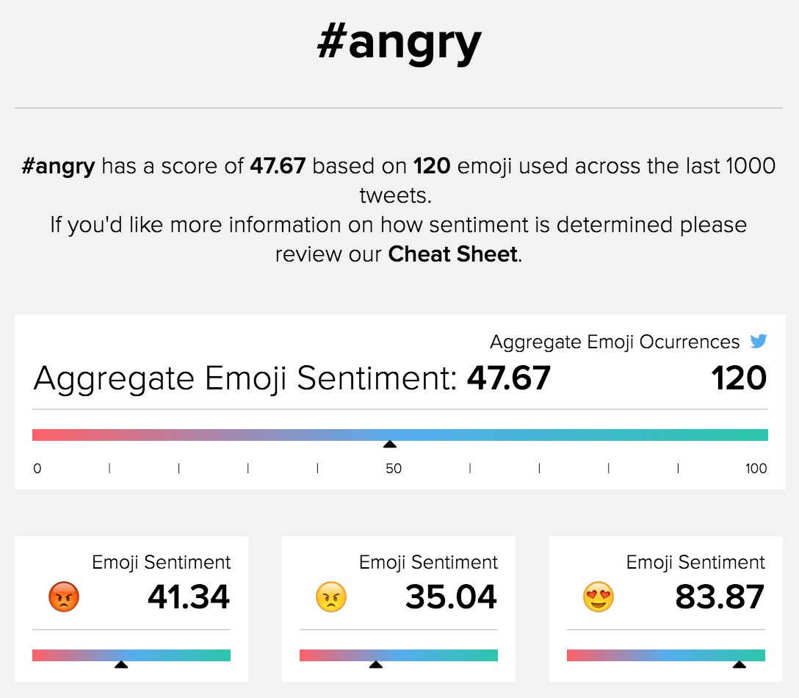
4. Sentiment Analysis
emojisentiment.com
Notes:
A different kind of approach with different corpus. Emojisentiment takes a hashtag and actually measures the emotional valence of the emoji. Then it adds up all the sentiment counts to give you a sense of sentiment for the hashtag. Interesting right? Made by students, full of problem, but shows that there are texts all out there, ready to read.

